Slide 1
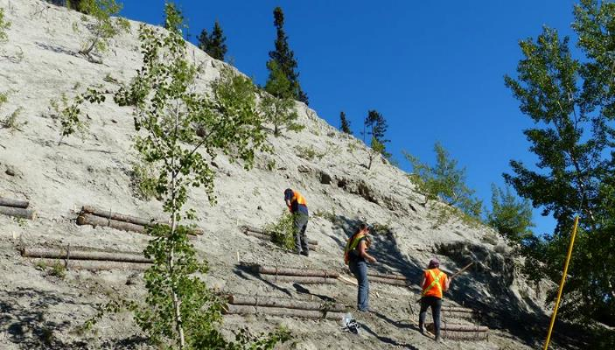
Urban Ecological Restoration
Letendre, A. & Stewart, K.J.
Yukon Research Centre/ Yukon College

Slide 2
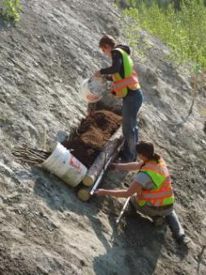
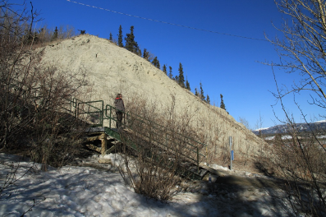
Ecological Restoration
Facilitate recovery of disturbed ecosystems
Kick start ecological processes

Slide 3
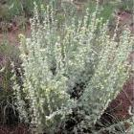
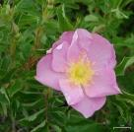
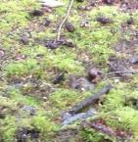
Ecological Restoration Bioengineering Native Plants
Invasive species management
Natural plant assemblage
Soil stability/nutrient
Erosion control
Revegetation
Notes:
Background on project ? Erosion issues , invasive etc.

Slide 4
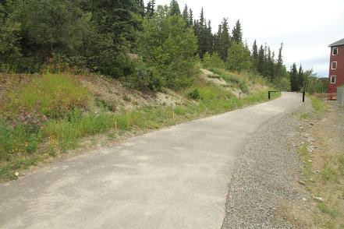
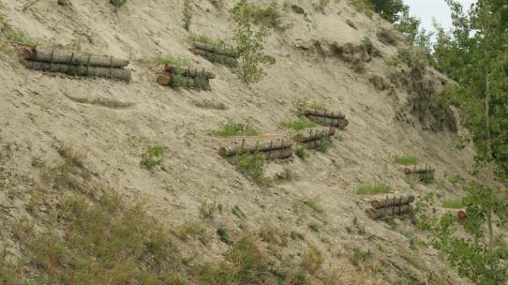
Study Sites
Pathway margins
- 6th / Wood
- 6th / Main
Black Street stairs
clay cliff
Notes:
Talk about bioengineering versus native species used at which sites
Metion sign

Slide 5
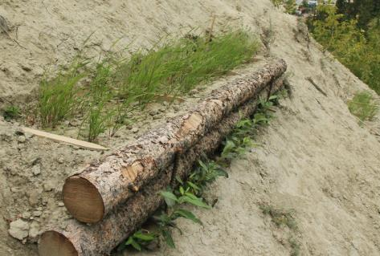
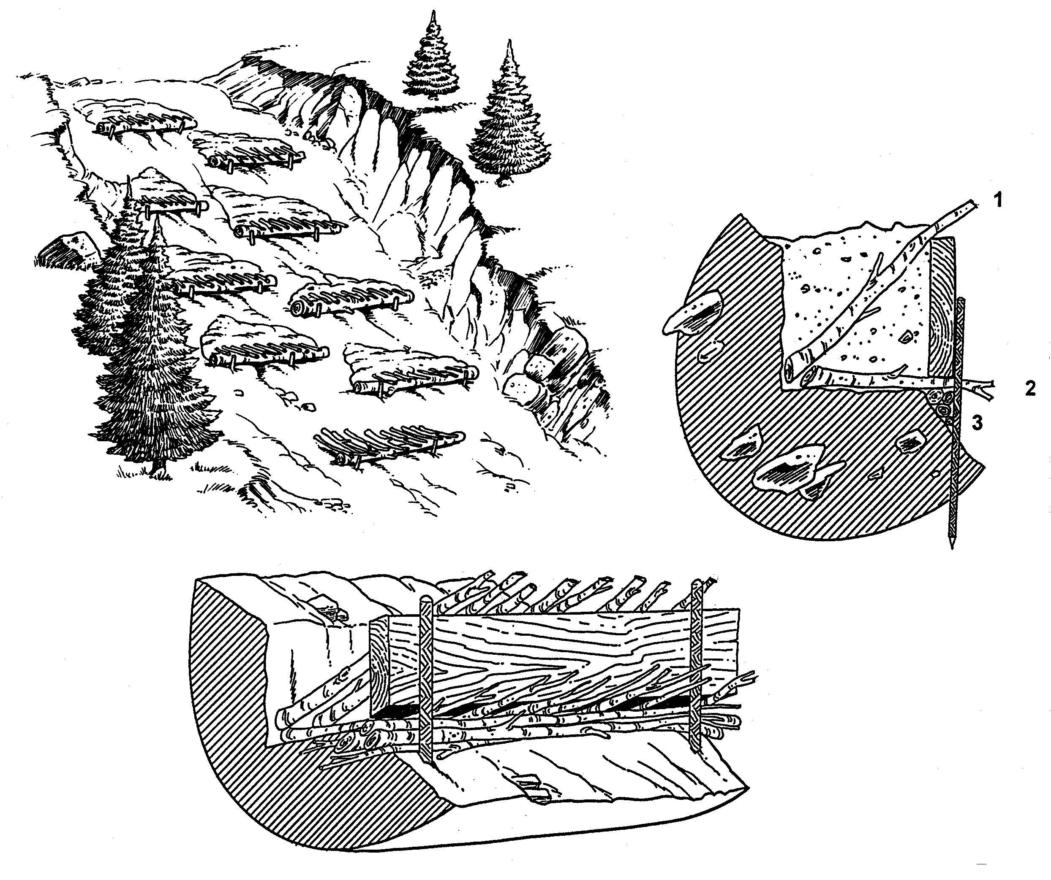
Methods – Modified Brush Layers (MBL)
15 erosion control structures built
Black St. stairs : 4 facing the stairs &
9 facing the trail
Each MBL seeded with native species
©David Polster
Notes:
Seed, soil amendments, BSC slurry (add slide ?)

Slide 6
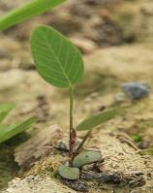
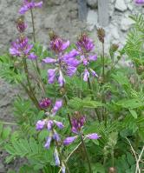
Methods - Seed Mix
MBL mix
35 % Elymus trachycaulus
(Slender wheatgrass)
35% Poa glauca
(Glaucous bluegrass)
15% Hedysarum spp.
(Sweetvetch)
13% Artemisia norvegica
(Sage)
2% Rosa acicularis
(Prickly rose)
Pathway margin mix
35 % Elymus trachycaulus
(Slender wheatgrass)
35% Poa glauca
(Glaucous bluegrass)
15% Hedysarum spp.
(Sweetvetch)
15% Achillea millefolium
(Yarrow)

Slide 7
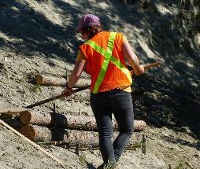
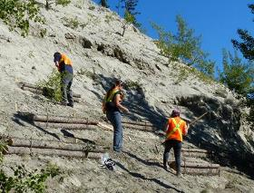
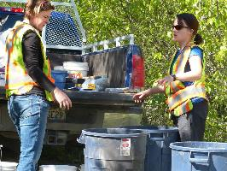
Objectives
Assess the survival of Salix alexensis and Populus balsamifera
Evaluate the establishment of native species
Measure nitrogen fixation rates of biocrusts

Slide 8
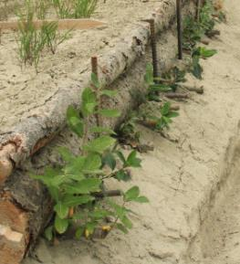
Results- Live Stakes
S. alexensis stakes had higher survival on cliff facing the stairs than on the cliff facing the trail

Slide 9
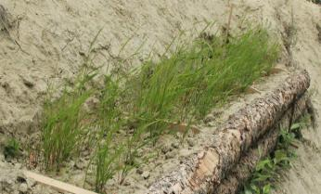
Results- Native Species
Of the seeded species, E. trachycaulus achieved the highest cover
Notes:
Where to insert germination table ?

Slide 10
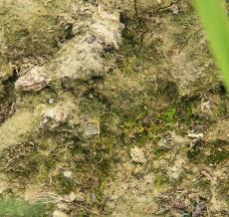
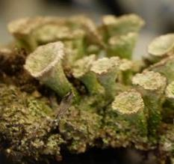
N-fixation was higher at MBL on the upper slope than on the lower slope
Results- Nitrogen Fixation

Slide 11
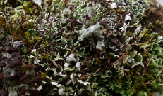
Conclusions
Assess the survival of Salix alexensis and Populus balsamifera
S. alexensis and P. balsamifera could be good candidate for revegetation projects in the Whitehorse area
Evaluate the establishment of native species
E. trachycaulus is the species from our seed mix that has performed the best
Measure nitrogen fixation rates of biocrusts
Biocrust on the upper slope had the highest fixation rates,
but those rates were relatively low

Slide 12
Acknowledgments
Special thanks to
Marc Boulerice, Matt Ball, Bruce Bennett,
David, Denise, Isobel, Justine, and Ziad

